Slide 1
mSF 502 Group Project -1
Ruthwik Reddy Vibhuti
Tanvi Patil Nithik Roshan
Abdoulie

Slide 2
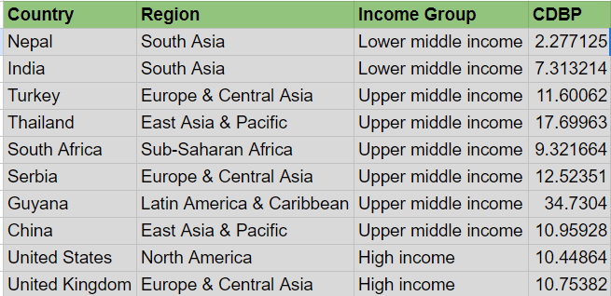
Cross - Sectional Data
Data :
https://datacatalog.worldbank.org/search/dataset/0061111/World-Development-Report-2022---Chapter-2-Figures

Slide 3
Introduction
The above data provides information about Capacity of banking systems to absorb increases in Non-Performing Loans (NPL's).
Variable Types:
Region, Income Group - Categorical Variables
CDBP(Consolidated Distance to Breakpoint)-Numerical Variable
Scale of Measurement :
Region and Income Group - Nominal Scale
CDBP - Ratio Scale

Slide 4
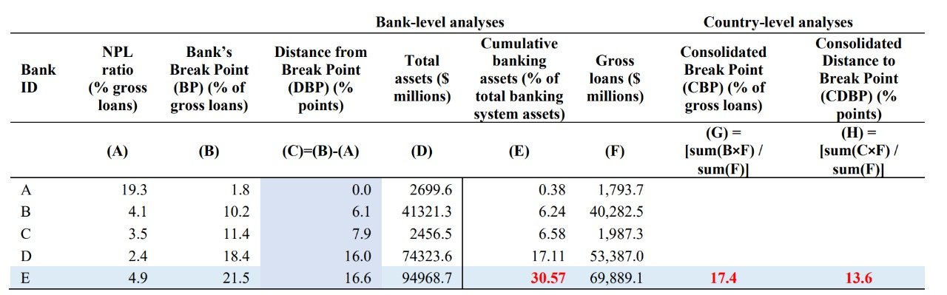
Calculation of CDBP

Slide 5
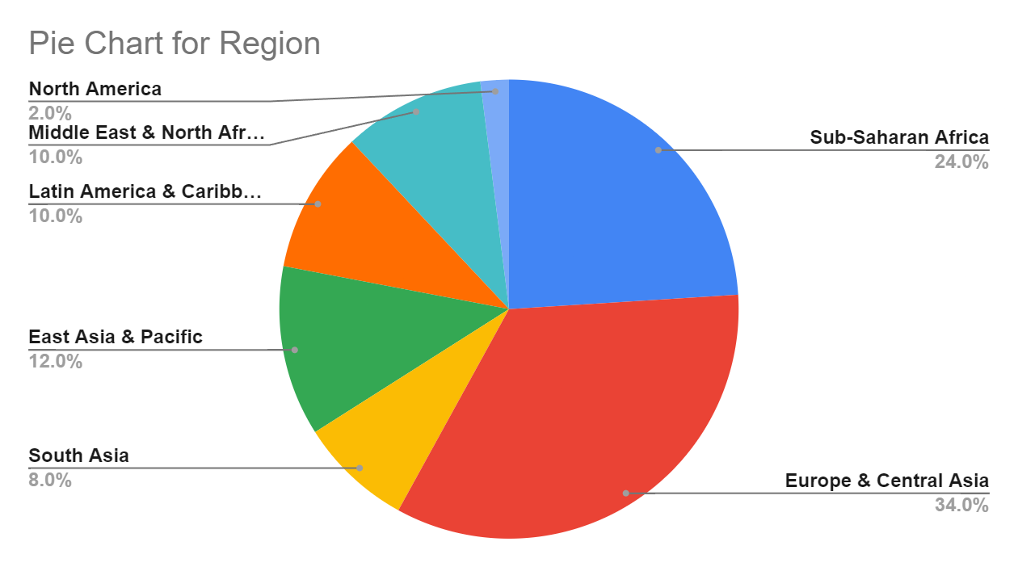
Univariate Analysis :
Around 60% of countries are from region Sub-saharan Africa or Europe & Central Asia

Slide 6
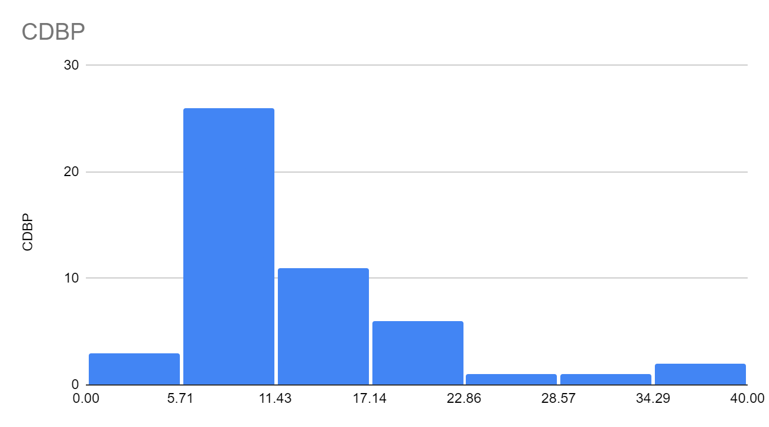
Around 50% of countries have CDBP in the range of 5.71-11.43

Slide 7
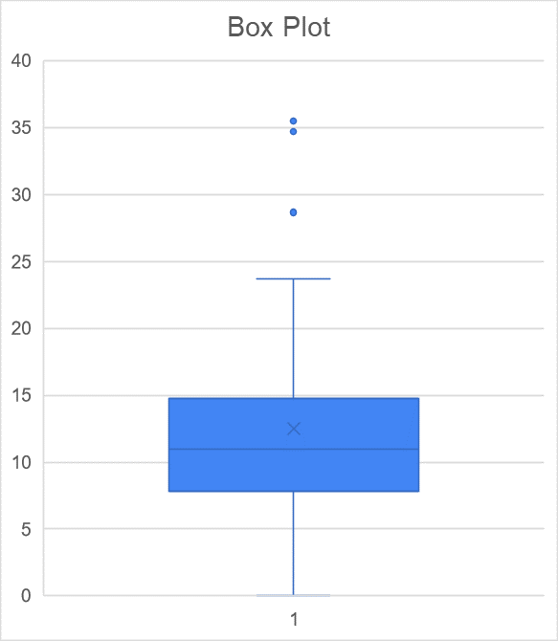
We can observe some outliers in the CDBP through graph.
The graph is little right-skewed.

Slide 8
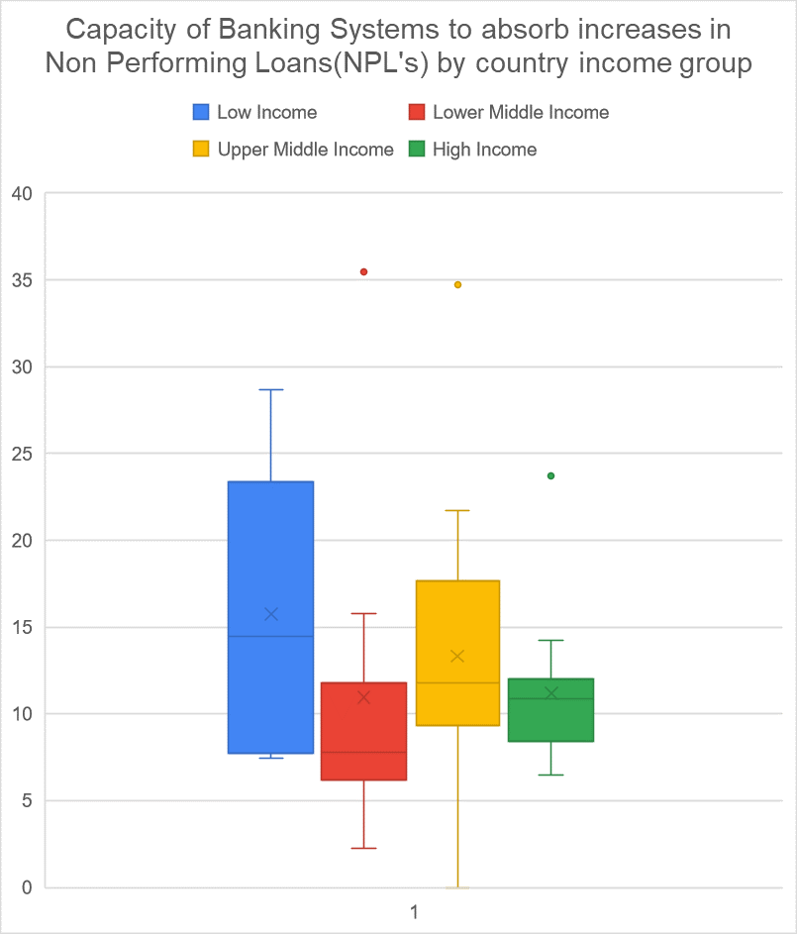
Bivariate ANalysis:
The Low Income countries has dispersed CDBP values i.e some countries have very less CDBP and some have very high.
High Income countries has CDBP values around median.

Slide 9
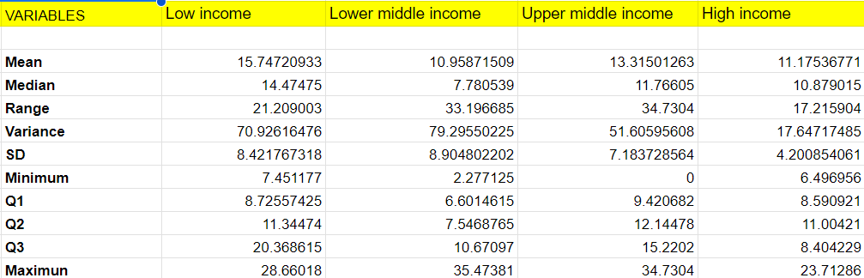

Slide 10
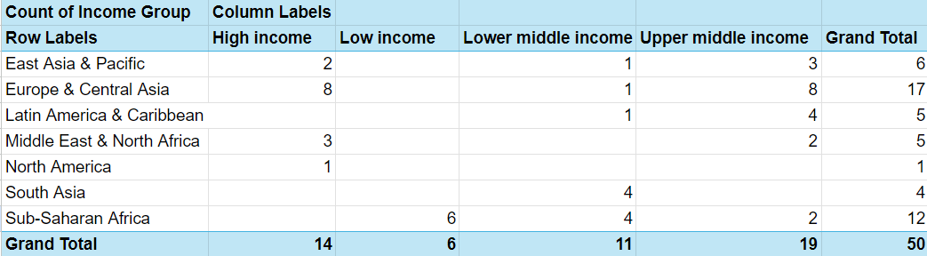
COntingency Table

Slide 11
Association
1. There is a strong association between being in Sub-Saharan Africa and being classified as low income, as all low-income countries in this dataset are from that region.
2. Europe & Central Asia have a higher concentration of high-income and upper middle income countries (8 out of 17), indicating a possible association between this region and higher economic status.

Slide 12
Probabilities
P(Low Income) = 6/50
P(Sub-saharan Africa) = 12/50
P(Low Income | Sub-Saharan Africa): 6/12
P(Sub-Saharan Africa | Low Income): 6/6 = 1
Indicating, that total Low-Income countries are from Sub-Saharan Africa.

Slide 13
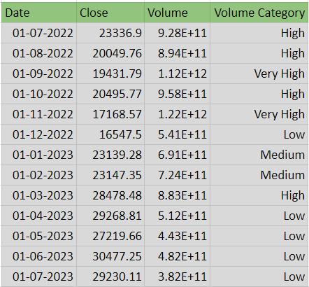
Time Series Data
Data:
Data Link : https://finance.yahoo.com/quote/BTC-USD

Slide 14
Introduction
The above data provides information about close price and volume of Cryptocurrency Bitcoin.
Variable types :
Close, Volume —> Continuous Variables
Volume Category —> Categorical Variable
Scale of Measurement:
Close, Volume → Ratio Scale
Volume Category → Nominal Scale

Slide 15
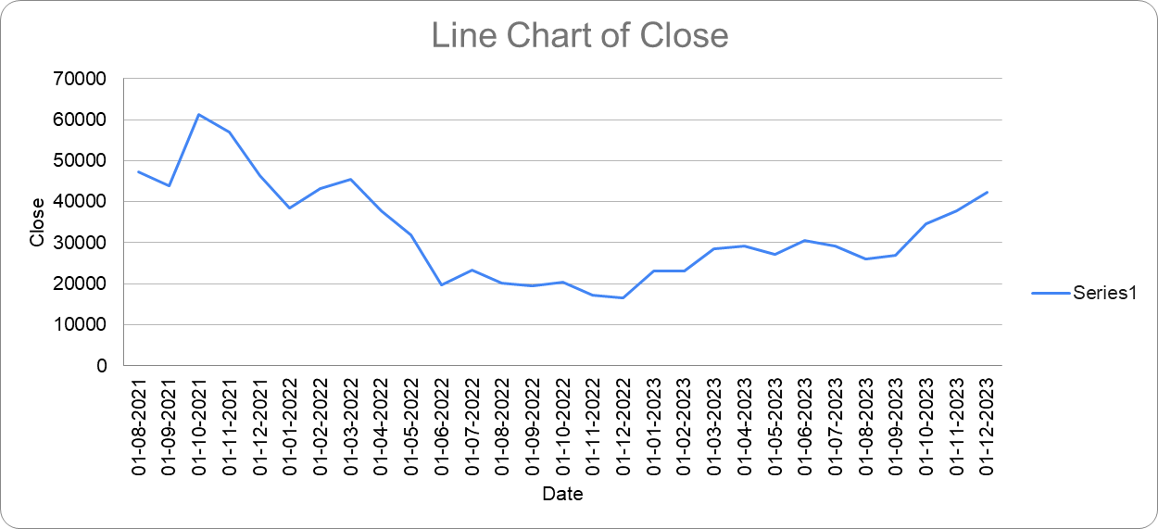
Univariate Analysis:

Slide 16
The price of Bitcoin is in it’s peak at 1|10|21.
The volume is very low in the period of Jun2022 - Dec2022

Slide 17
Bivariate AnALYSIS:
We can observe that when the price of bitcoin is very low, the Volume is very high, indicating the price drop is due to more Selling that happened which we can see in volume graph.

Slide 18
